Slide 1
DECISION TREE CLASSIFIER
Sourav Karmakar
souravkarmakar29@gmail.com

Slide 2
OUTLINE
What is a Decision Tree Classifier
Example of a Decision Tree Classifier
Building a Decision Tree from a dataset
Specifying test conditions
Determining best split
Calculating node impurity
Determining node impurity and best split using GINI index
When to stop splitting
Merits and Demerits of Decision Tree

Slide 3
DECISION TREE CLASSIFIER
A Decision Tree splits the dataset using the structure of a tree and it makes a decision at every node.
Root Node
Internal Nodes
Leaf Nodes
What does each component describe?
Root Node and Internal Nodes
Test on a attribute / feature
Branches
Outcomes of the test on attributes
Leaf Nodes
Target Class Label

Slide 4
EXAMPLE OF A DT CLASSIFIER
Creating a Model:
We can fit a Decision Tree like following for the given training data.
ID | Refund | Marital Status | Taxable Income | Cheat
1 | Yes | Single | 125K | No
2 | No | Married | 100K | No
3 | No | Single | 70K | No
4 | Yes | Married | 120K | No
5 | No | Divorced | 95K | Yes
6 | No | Married | 60K | No
7 | Yes | Divorced | 220K | No
8 | No | Single | 85K | Yes
9 | No | Married | 75K | No
10 | No | Single | 90K | Yes
Refund
Yes
No
NO
Mar. St.
Single, Divorced
Married
Tax. Inc.
NO
< 80K
> 80K
Class
NO
YES
Categorical
Categorical
Continuous

Slide 5
EXAMPLE OF A DT CLASSIFIER
Applying the model on a test data:
Start from the Root
Test Data
Refund | Marital Status | Taxable Income | Cheat
No | Married | 80K | ?
Refund
Yes
No
NO
Mar. St.
Single, Divorced
Married
Tax. Inc.
NO
< 80K
> 80K
NO
YES

Slide 6
EXAMPLE OF A DT CLASSIFIER
Applying the model on a test data:
Test Data
Refund | Marital Status | Taxable Income | Cheat
No | Married | 80K | ?
Refund
Yes
No
NO
Mar. St.
Single, Divorced
Married
Tax. Inc.
NO
< 80K
> 80K
NO
YES

Slide 7
EXAMPLE OF A DT CLASSIFIER
Applying the model on a test data:
Test Data
Refund | Marital Status | Taxable Income | Cheat
No | Married | 80K | ?
Refund
Yes
No
NO
Mar. St.
Single, Divorced
Married
Tax. Inc.
NO
< 80K
> 80K
NO
YES

Slide 8
EXAMPLE OF A DT CLASSIFIER
Applying the model on a test data:
Test Data
Refund | Marital Status | Taxable Income | Cheat
No | Married | 80K | ?
Refund
Yes
No
NO
Mar. St.
Single, Divorced
Married
Tax. Inc.
NO
< 80K
> 80K
NO
YES

Slide 9
EXAMPLE OF A DT CLASSIFIER
Applying the model on a test data:
Test Data
Refund | Marital Status | Taxable Income | Cheat
No | Married | 80K | ?
Refund
Yes
No
NO
Mar. St.
Single, Divorced
Married
Tax. Inc.
NO
< 80K
> 80K
NO
YES

Slide 10
EXAMPLE OF A DT CLASSIFIER
Applying the model on a test data:
Test Data
Refund | Marital Status | Taxable Income | Cheat
No | Married | 80K | ?
Refund
Yes
No
NO
Mar. St.
Single, Divorced
Married
Assign Cheat to “No”
Tax. Inc.
NO
< 80K
> 80K
NO
YES

Slide 11
DECISION TREE BUILDING (INDUCTION)
There are many algorithms to construct a Decision Tree from labelled training dataset.
Hunt’s Algorithm
CART (Short form of Classification And Regression Tree)
ID3 (ID stands for Iterative Dichotomiser)
C4.5
SLIQ (Supervised Learning In Quest)
SPRINT (Scalable PaRallelizable INduction of decision Trees)

Slide 12
DECISION TREE BUILDING (INDUCTION)
Greedy Strategy:
Split the records based on an attribute test that optimizes certain criteria.
Issues:
Determine how to split the records.
How to specify attribute test conditions?
How to determine best split?
Determine when to stop splitting.

Slide 13
HOW TO SPECIFY TEST CONDITIONS
Depends on attributes types
Categorical
Continuous
Depends on number of ways to split
2-way split
Multiway Split
Splitting based on Categorical Attribute:
Smoking Habit
Marital Status
Divorced
Smoker
Non-smoker
Single
Married
Multiway Split
2-way Split

Slide 14

HOW TO SPECIFY TEST CONDITIONS
Depends on attributes types
Categorical
Continuous
Depends on number of ways to split
2-way split
Multiway Split
Splitting based on Continuous Attribute:
Age
Income
> 50K
< 40
< 25K
25K – 50K
Multiway Split
2-way Split

Slide 15
HOW TO DETERMINE BEST SPLIT
Nodes with homogeneous class distribution are preferred.
Need a measure of Node impurity.
Intuition:
Consider a binary classification problem.
Following scenarios are observed in two different nodes.
# Class-1 : 10
# Class-1 : 18
# Class-2 : 10
# Class-2 : 2
Non-homogenous Node
High degree of impurity
Needs further split
More Homogenous Node
Low degree of impurity

Slide 16


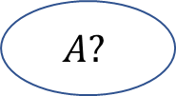
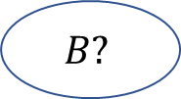











HOW TO DETERMINE BEST SPLIT
Before splitting:
C1 | N01
C2 | N02
Yes
No
Yes
No
C1 | N11
C2 | N12
C1 | N21
C2 | N22
C1 | N31
C2 | N32
C1 | N41
C2 | N42

Slide 17
MEASURES OF NODE IMPURITY
There are various ways to measure Node impurity
GINI Index: Used in CART, SLIQ, SPRINT.
Information Gain: Used in ID3 and C4.5
Misclassification Error
And Many More…
In this lecture we shall discuss GINI index for computation of impurities.

Slide 18

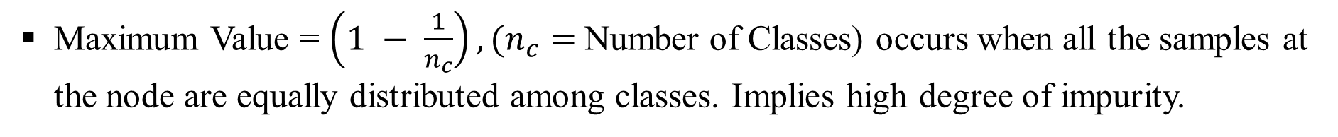
MEASURE OF IMPURITY : GINI
Minimum Value = 0, occurs when all the samples at the node belong to one class. Implies homogeneity.

Slide 19






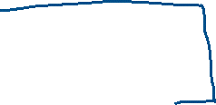



Slide 20

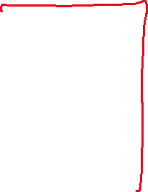



Slide 21






Slide 22
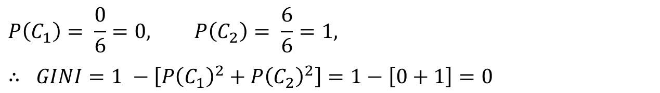
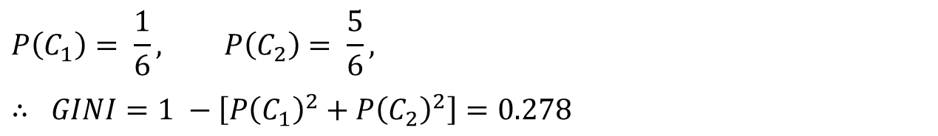
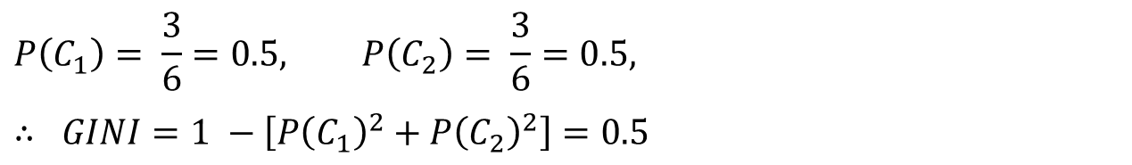
MEASURE OF IMPURITY : GINI
Examples of computing GINI index:
C1 | 0
C2 | 6
C1 | 1
C2 | 5
C1 | 3
C2 | 3

Slide 23
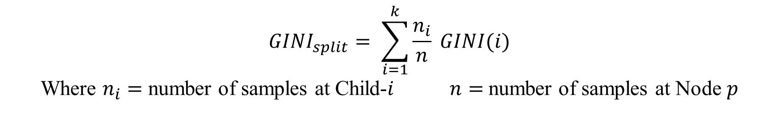

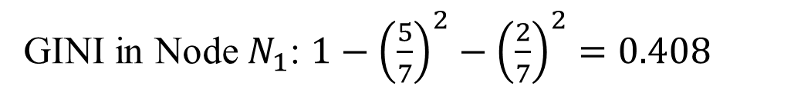


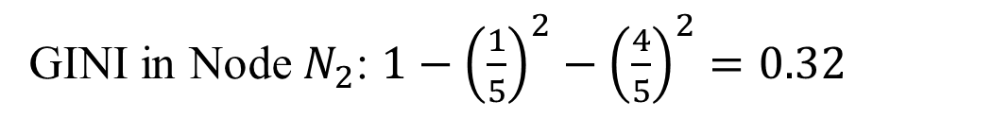
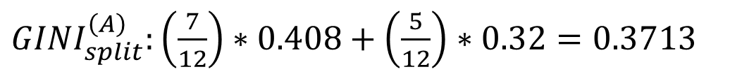
SPLITTING BASED ON GINI
C1 | 6
C2 | 6
Distribution in Parent Node
GINI = 0.5
Yes
No
C1 | 5
C2 | 2
C1 | 1
C2 | 4

Slide 24

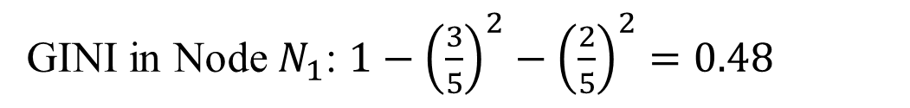


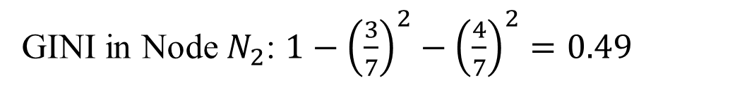
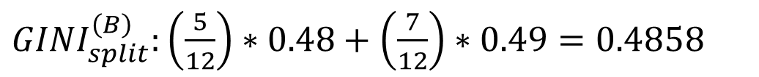
SPLITTING BASED ON GINI
Now let’s consider another attribute for splitting:
C1 | 6
C2 | 6
Distribution in Parent Node
GINI = 0.5
Yes
No
C1 | 3
C2 | 2
C1 | 3
C2 | 4

Slide 25



WHEN TO STOP SPLITTING
Growing of decision tree (Tree Induction Algorithm) can be stopped by following criteria:
When there are no records / samples to split further, that is when each of the training sample belong to one of the leaf nodes.
When the leaf nodes are homogeneous or nearly homogeneous.
When the tree height is equal to some predefined height.
When the gain of split at a node is not more than a predefined value.

Slide 26
DECISION TREE : MERITS AND DEMERITS
Merits:
Inexpensive to construct, i.e. it takes less time and effort to build a decision tree.
Extremely fast at classifying unknown records.
Highly interpretable model for small-sized tree.
Can work on both categorical and quantitative attributes.
Feature scaling and normalization is not required.
Somewhat robust to missing values.
Demerits:
Highly prone to overfit (i.e. low bias but high variance).
A small change in the training data can cause a large change in the structure of the decision tree causing instability.

Slide 27


















Slide 28
























Slide 29




































Slide 30
Thank You

